Slide 1
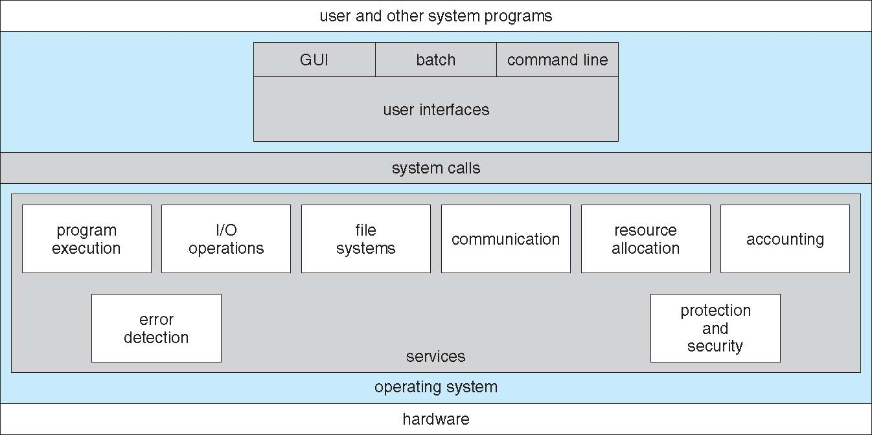
A View of Operating System Services

Slide 2
System Calls
Programming interface to the services provided by the OS
Typically written in a high-level language (C or C++)
Mostly accessed by programs via a high-level Application Programming Interface (API) rather than direct system call use
Three most common APIs are Win32 API for Windows, POSIX API for POSIX-based systems (including virtually all versions of UNIX, Linux, and Mac OS X), and Java API for the Java virtual machine (JVM)
Note that the system-call names used throughout this text are generic

Slide 3
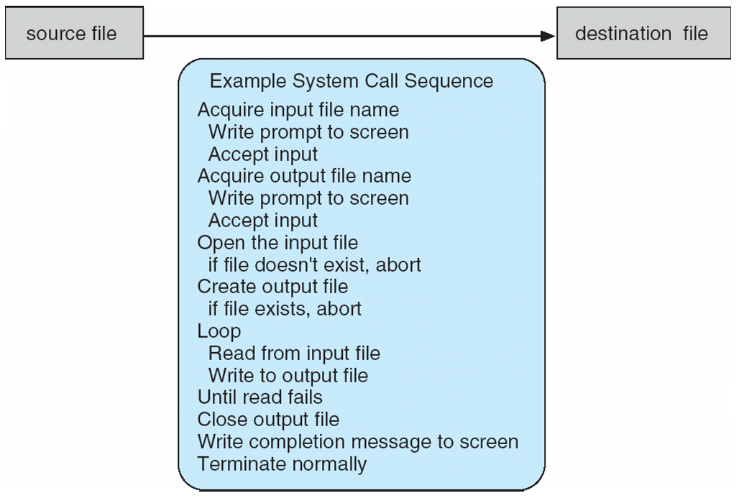
Example of System Calls
System call sequence to copy the contents of one file to another file

Slide 4
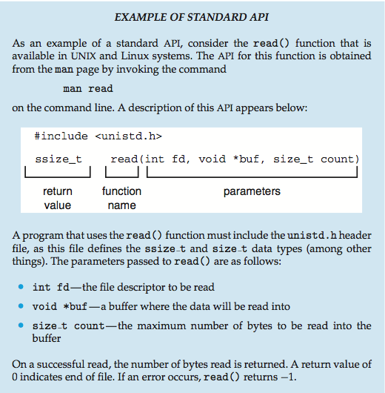
Example of Standard API

Slide 5
System Call Implementation
Typically, a number associated with each system call
System-call interface maintains a table indexed according to these numbers
The system call interface invokes the intended system call in OS kernel and returns status of the system call and any return values
The caller need know nothing about how the system call is implemented
Just needs to obey API and understand what OS will do as a result call
Most details of OS interface hidden from programmer by API
Managed by run-time support library (set of functions built into libraries included with compiler)

Slide 6
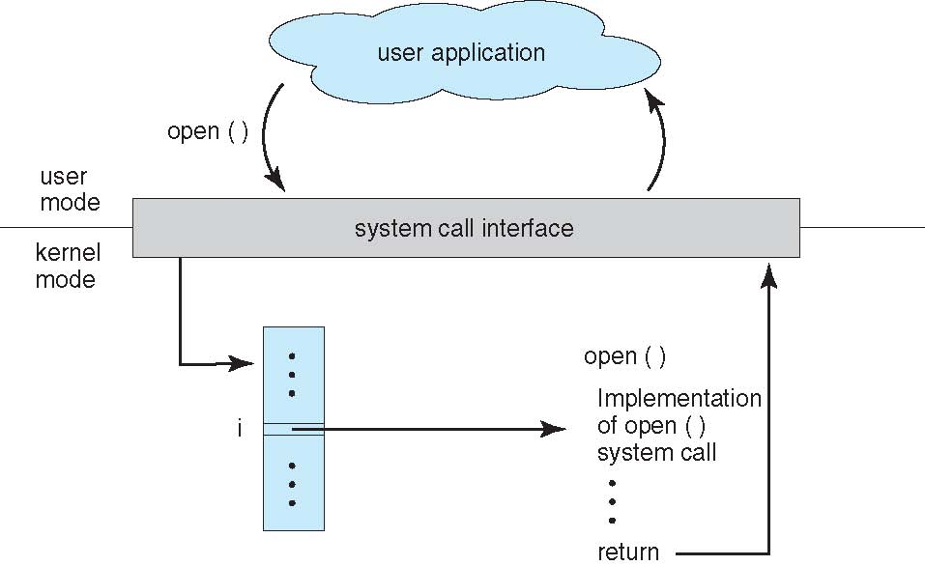
API – System Call – OS Relationship

Slide 7
System Call Parameter Passing
Often, more information is required than simply identity of desired system call
Exact type and amount of information vary according to OS and call
Three general methods used to pass parameters to the OS
Simplest: pass the parameters in registers
In some cases, may be more parameters than registers
Parameters stored in a block, or table, in memory, and address of block passed as a parameter in a register
This approach taken by Linux and Solaris
Parameters placed, or pushed, onto the stack by the program and popped off the stack by the operating system
Block and stack methods do not limit the number or length of parameters being passed

Slide 8
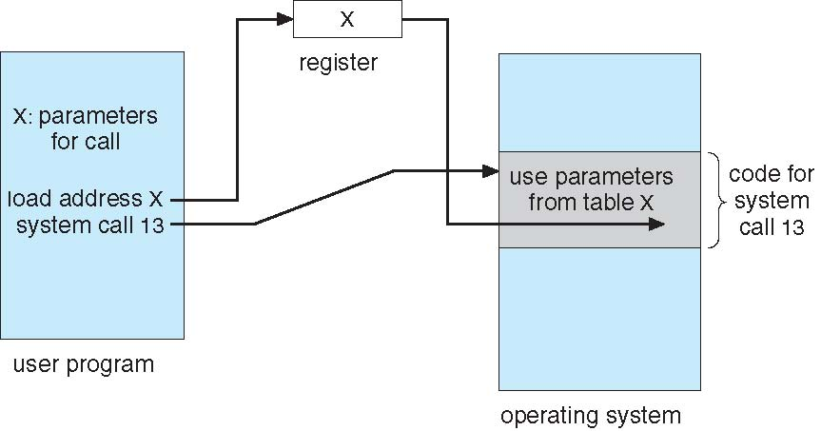
Parameter Passing via Table

Slide 9
Types of System Calls
Process control
create process, terminate process
end, abort
load, execute
get process attributes, set process attributes
wait for time
wait event, signal event
allocate and free memory
Dump memory if error
Debugger for determining bugs, single step execution
Locks for managing access to shared data between processes

Slide 10
Types of System Calls
File management
create file, delete file
open, close file
read, write, reposition
get and set file attributes
Device management
request device, release device
read, write, reposition
get device attributes, set device attributes
logically attach or detach devices

Slide 11
Types of System Calls (Cont.)
Information maintenance
get time or date, set time or date
get system data, set system data
get and set process, file, or device attributes
Communications
create, delete communication connection
send, receive messages if message passing model to host name or process name
From client to server
Shared-memory model create and gain access to memory regions
transfer status information
attach and detach remote devices

Slide 12
Types of System Calls (Cont.)
Protection
Control access to resources
Get and set permissions
Allow and deny user access

Slide 13
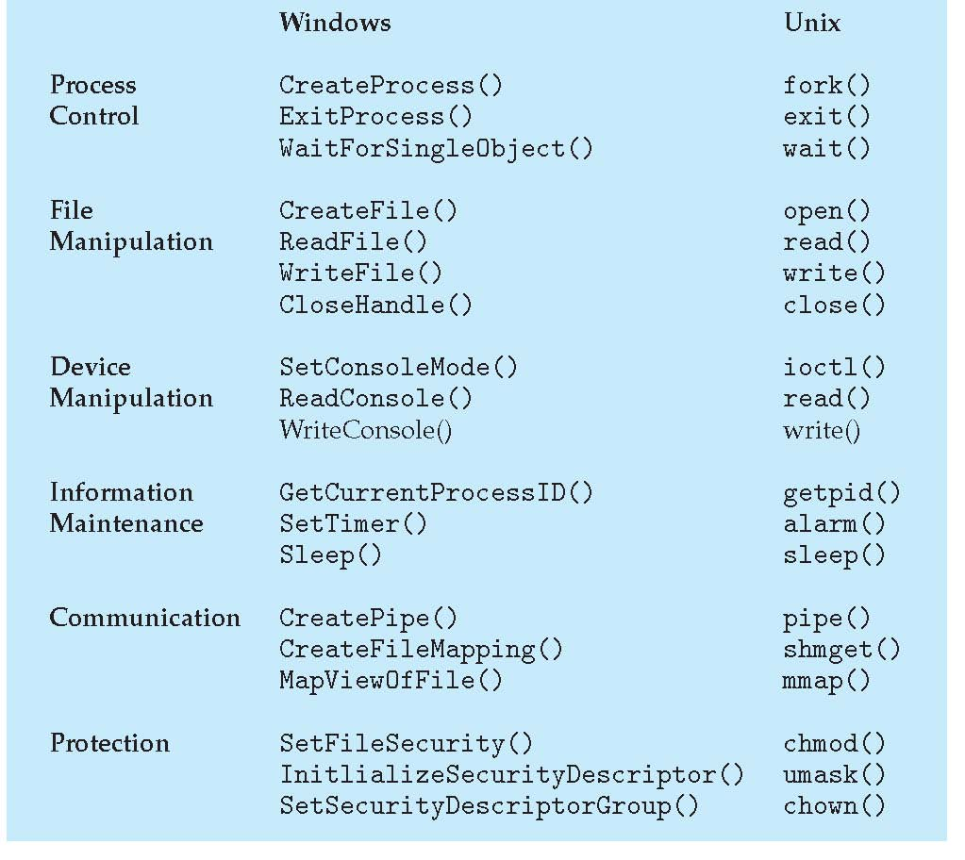
Examples of Windows and Unix System Calls

Slide 14
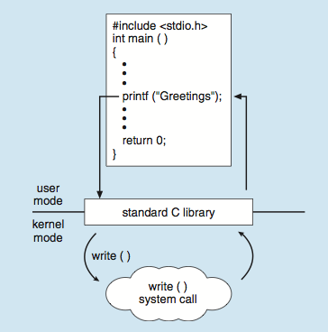
Standard C Library Example
C program invoking printf() library call, which calls write() system call

